Slide 1
Invitation to Salvation

Slide 2
Invitation to Salvation
In personal evanagelism, we want to have an invitation to Christ (when new/unbelievers attend):
  Jesus-focused (the gospel)
  Include elements of repentance, belief and confession
  Brief
  May include a brief testimony of your or another member’s salvation testimony

Slide 3
The Gospel
The good news that Jesus died for our sins
Sin separates but Jesus died for our sins, was buried and raised so that we can be reconciled to God
Mark 16:15
  And he said unto them, Go ye into all the world, and preach the gospel to every creature.
Luke 24:47
  And that repentance and remission of sins should be preached in his name among all nations, beginning at Jerusalem.
Various outlines you can use (Roman Road, Peace with God, etc.)
  http://evangelism.intervarsity.org/resource/how-choose-gospel-outline

Slide 4
Invitation to Salvation
If there is no mention of repentance, sin, confession, redemption, grace, and trusting in Christ, people may never come to saving faith in Christ. The Word has real power and that power must be unleashed. Let me say clearly that the way a person is saved is not just by an altar call, or by filling out a decision card, or by praying a sinner’s prayer.
  The Holy Spirit convicts the person of their sins,
  God grants them repentance,
  The person pours out their heart in confessing their sin, and they lean fully upon the name of Jesus Christ and trusting in Him alone.
Salvation is fully a work of God alone, but we have the great privilege of entering into the fields for the harvest and the fields are ripe. We can sow the seed of the Word, join in the labor of others, and leave the results up to God. It is not our responsibility to save anyone. It is their response to His ability but it is our responsibility to tell them.
All believers are ministers commanded to proclaim the gospel and since faith comes by hearing and hearing by the Word of God, how can they be saved unless you tell them? That saving faith must be regularly and consistently given in AFG meetings.

Slide 5

Outlines

Slide 6
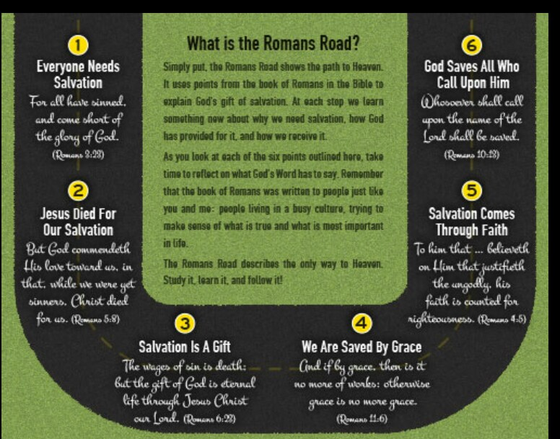
Outlines

Slide 7
Romans Road Scriptures
for all have sinned and fall short of the glory of God,
—Romans 3:23
For the wages of sin is death, but the free gift of God is eternal life in Christ Jesus our Lord.
—Romans 6:23
but God shows his love for us in that while we were still sinners, Christ died for us.
—Romans 5:8
because, if you confess with your mouth that Jesus is Lord and believe in your heart that God raised him from the dead, you will be saved. For with the heart one believes and is justified, and with the mouth one confesses and is saved.
—Romans 10:9-10
Therefore, since we have been justified by faith, we have peace with God through our Lord Jesus Christ.
—Romans 5:1

Slide 8

Outlines

Slide 9
Activity
Your Salvation Testimony

Slide 10
Follow-up & Building Community

Slide 11
Outside of Church Services
“The best ministry generally doesn’t occur during a group’s meetings so much as between the meetings. Every chance you have to touch people between meetings helps them become excited enough to want to come to the next meeting.” – Carl George

Slide 12
Follow-up
The Family of God provides a solid metaphor for Body Life – “living on mission together”
We do not have enough time in a weekly meeting to be the family of God
The meeting is not the place for all ministry to take place
The meeting is not the time when all needs are met
The only choice is to be family for one another during the rest of the week

Slide 13
Outside of Church Services
Edify one another (1 Thessalonians 5:11)
Love one another (John 13:34, 1 Peter 1:22)
Forgive one another (Ephesians 4:32, Colossians 3:13)
Pray for one another (James 5:16)
Serve one another (Galatians 5:13)
Offer hospitality to one another (1 Peter 4:9)
Admonish one another (Colossians 3:16)

Slide 14
Follow-up
Do this and encourage all group members to also:
  Call those who have been out – keep an accurate list of your group contacts*
  Follow up on visitors
  Pray for each other, especially anyone who is sick
    Home prayer visits (stay no longer than 30min)
    How are you doing?
    Do you have specific needs we can pray for?
    Do you have friends of family that need the Lord that we can pray for?
  Visit the hospital
  Lead people to Christ

Slide 15
Practical ways to facilitate Follow-up
Use the phone
Invite someone over for dinner
Baby-sit for a couple or single mother
Help someone move
Tackle a mission project together
Pray for each other
Sit together at worship weekly
Make home prayer visits
Have a “guys night out” or a “girls night out”

Slide 16
Your Weekly Activities
Dream of leading a healthy, growing group
Pray for your group members
Invite new people
Contact group members
Mentor assistants/apprentice/potential leaders
Prepare for the group meeting
Be committed to your personal growth

Slide 17
Neighborhood Evangelism

Slide 18
Monthly Evangelism
1 weekly meeting out of the month must be devoted to reaching your neighborhood/evangelism/outreach
Cast this vision early and frequently to avoid the group becoming a social club for Christians only

Slide 19
Help members wrestle with the call to Evangelism
Start with Vision and Prayer:
  Spend time during the meeting to share the group’s vision to reach to the lost
  Let members identify friends, family and co-workers they want to see come to Christ
    Make a list and pray for them during the group meeting
  The “Empty Chair” prayer
  Help them write their salvation testimony as you did this week
  Share the witnessing outlines (Romans Road, Peace with God, ABCs of Salvation, etc.)

Slide 20
Make Visitors Feel Welcome in your Meeting
Your meeting is not a Christian-only, closed meeting
Meet consistently:
  Once per week
  Same night and time
  If you rotate homes, make sure you communicate clearly to potential newcomers
Reject the “family-reunion” mentality:
  Inside jokes
  Common group stories newcomers would not know or relate to
  Foreign languages that newcomers don’t know
  Religious jargon
Make them welcome them and give them time to introduce themselves/icebreaker
Follow-up on Visitors

Slide 21
Make Contact with your Neighborhood
Hold a totally free car wash (give everyone an invitation card to your weekly meeting, church flyer)
Give away soft drinks/bottle water
Rake leaves/shovel snow for others as an act of kindness (leave an invitation card/church flyer)
Hold a block party/BBQ
Prayer walk your neighborhood (know on doors and ask if they would like prayer (leave an invite card/flyer)
Get to know your neighbors/neighborhood
Build relationships in your community and encourage every member to do the same

Slide 22
Make Contact with Your Neighborhood
Other ideas?
What do you know about your neighborhood?

